Slide 1

Shri Ramdeobaba College Of Engineering And Management
H-1B Workers in the Context of Cyber Law and Ethics
This presentation explores the intersection of H-1B visa programmes, cyber law, and ethical responsibilities for foreign tech professionals. It highlights legal protections, employer obligations, common violations, and best practices to ensure compliance and security in the digital age.
Presented by:
Aruja Singh A-52
Diyan Ali A-53
Sai Ambulkar A-54

Slide 2

Understanding H-1B Workers: Who and What?
Specialty Occupations
Educational Requirements
H-1B visa holders are skilled foreign professionals in roles requiring theoretical and practical expertise, typically in technology sectors like software development and cybersecurity.
Applicants must possess at least a bachelor's degree or equivalent work experience directly related to the position, ensuring they contribute advanced knowledge to U.S. employers.
Relevance to Cyber Fields
Many work in IT, engineering, and cyber-related jobs, where handling sensitive data makes adherence to cyber laws and ethical standards critically important for all parties involved.

Slide 3
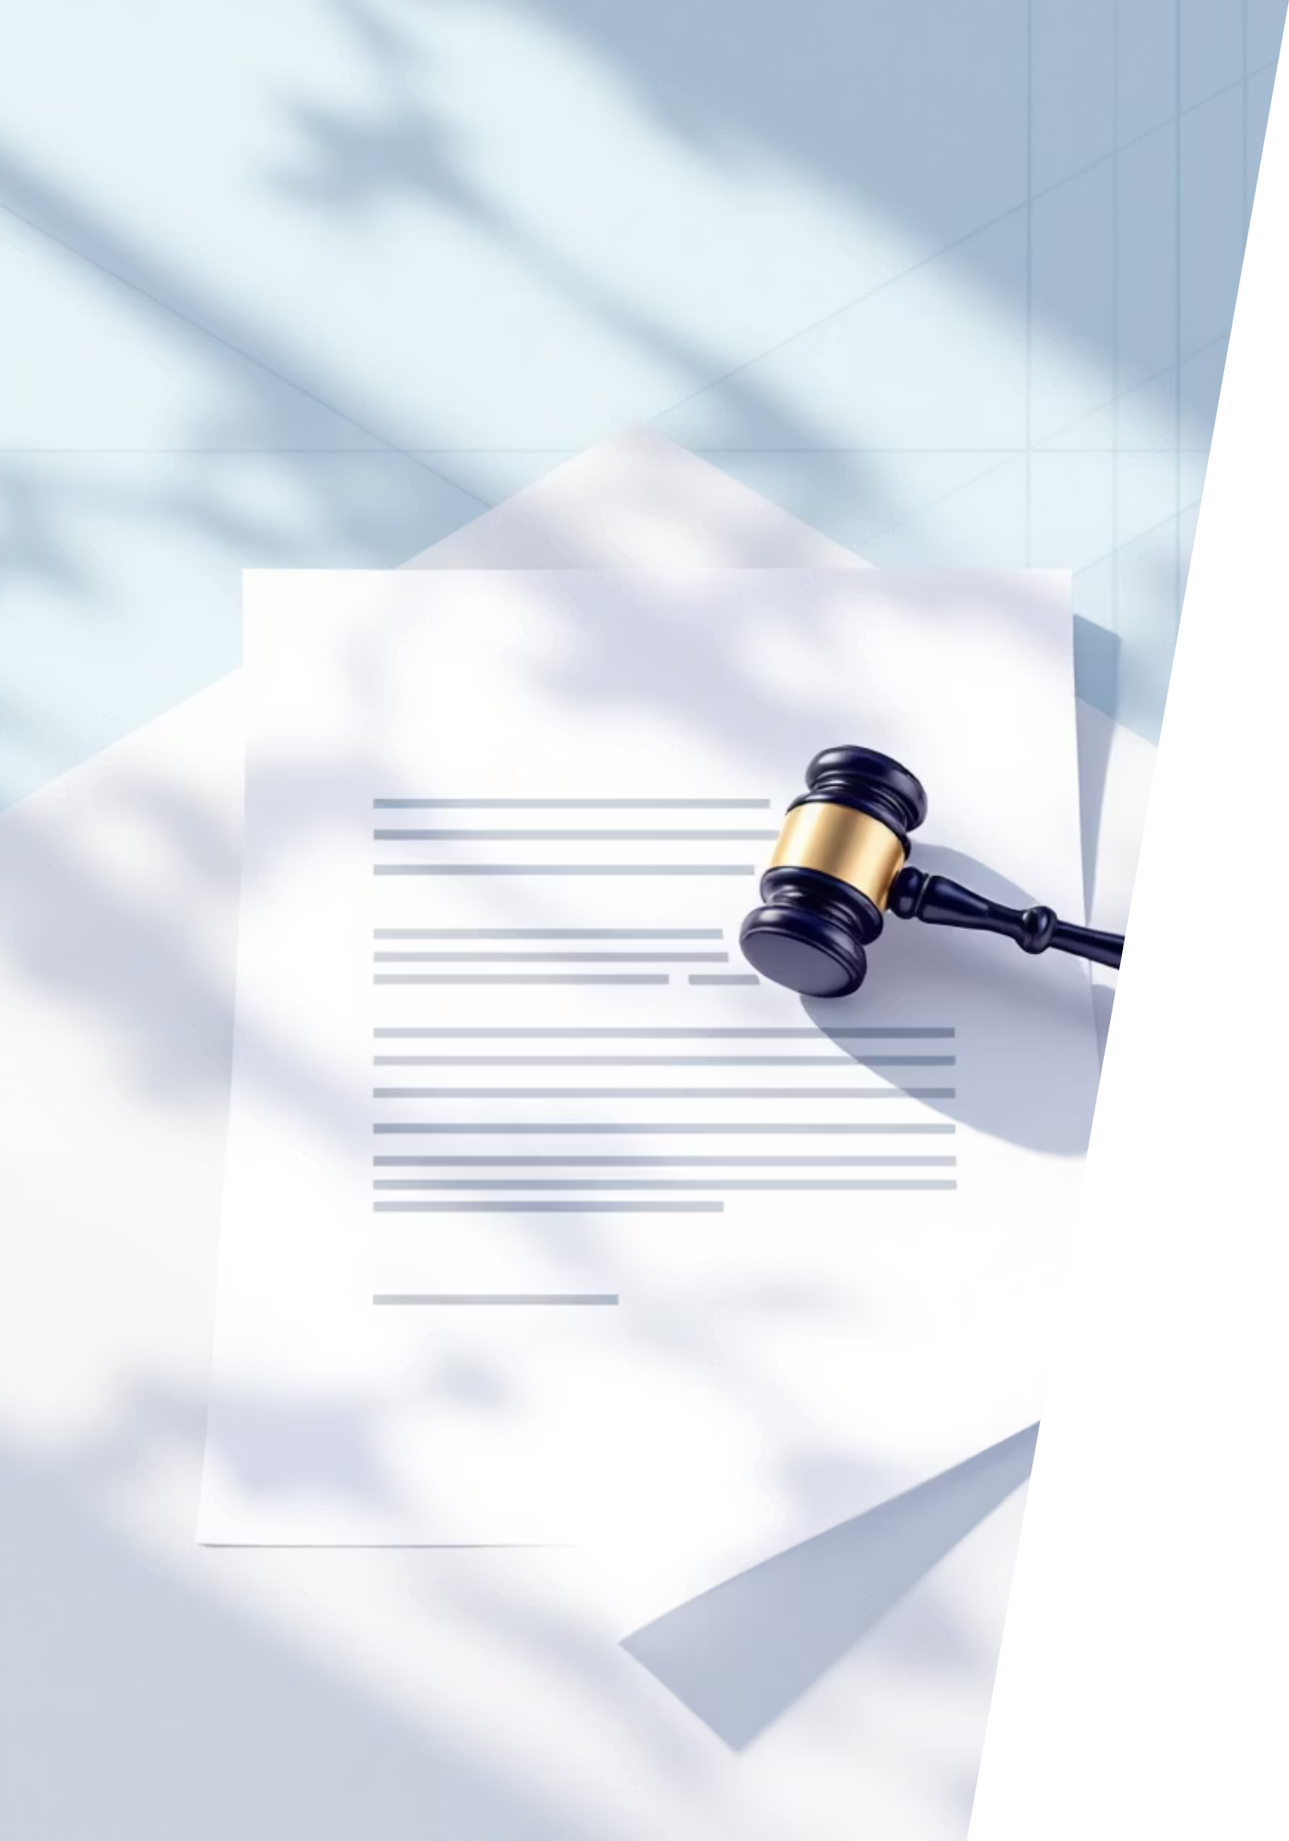
Legal Protections for H-1B Workers
Wage and Condition Standards
Anti-Discrimination Measures
Employers are required to pay H-1B workers the actual wage paid to similar U.S. employees or the prevailing wage for the role, whichever is higher. This ensures fair compensation and prevents exploitation.
Workers receive identical benefits, working conditions, and protections as U.S. counterparts. Discrimination based on nationality or visa status is prohibited, fostering an equitable workplace.
Employers cannot charge workers for visa fees, legal costs, or retaliate against those reporting violations, safeguarding their financial and job security.
H-1B professionals have the right to inspect compliance records, empowering them to verify adherence to labour laws and seek redress if needed.

Slide 4




Employer Obligations & Compliance Under Cyber Law
Labor Condition Applications (LCAs)
Intersection with Cyber Law
Handling employee data, digital records, and secure communications requires adherence to cyber regulations, integrating data privacy into H-1B obligations to protect sensitive information.
Employers must file accurate LCAs attesting to fair wages, working conditions, and non-displacement of U.S. workers, forming the foundation of H-1B compliance.
Consequences of Non-Compliance
Violations trigger U.S. Department of Labor audits, fines up to £27,500 per infraction, orders for back wages, and potential criminal charges for fraud or document falsification.
Robust compliance not only avoids penalties but also builds trust in cyber-secure environments where H-1B workers operate.

Slide 5
H1B Violations
Employer Violations
Wage-related Violations
Paying below prevailing wage.
Illegal deductions (visa fees, bench time costs).
“Bench Time” Issues
Not paying employees when no work is assigned.
Job Role & Location Misrepresentation
Assigning tasks outside petitioned occupation.
Moving employee without new LCA & amendment.
Public Access File (PAF) Failures
Not maintaining required compliance documentation.
Unauthorized Placement
Subcontracting or client-site placement without proper employer-employee relationship.
Employee Violations
Unauthorized Employment
Working for another employer without transfer approval.
Failure to Maintain Status
Staying unemployed beyond 60-day grace period.
Not reporting material changes in employment.
Scope of Work Issues
Taking side jobs, freelancing, or unauthorized self-employment.

Slide 6

H-1B Penalties for Non-Compliance
Significant Financial Penalties
Employers face civil fines up to £27,500 per violation, depending on the severity and nature of the infraction. Repeated offences can lead to even higher penalties.
Debarment from Visa Programmes
Severe and repeated violations can result in debarment, preventing employers from sponsoring any foreign workers for a specified period, impacting their ability to hire skilled talent.
Criminal Charges
In cases of fraud, misrepresentation, or document falsification, employers and individuals can face criminal charges, leading to imprisonment and substantial fines.
Visa Revocation
H-1B visas for affected workers may be revoked, leading to their removal from the U.S. and potential re-entry bans, severely impacting their careers and personal lives.

Slide 7




Cyber Ethics in the Workplace: Responsibilities of H-1B Workers
Privacy and Access
H-1B workers must respect colleague and client privacy, avoiding unauthorised access to systems or data, which upholds trust and prevents breaches.
Avoiding Malicious Practices
Ethical conduct prohibits hacking, phishing, or using pirated software, ensuring no misuse of proprietary information that could compromise company security.
Promoting Security
Adhering to standards fosters data protection, intellectual property respect, and compliance with laws like the UK's Data Protection Act, building a secure workplace culture.
By prioritising ethics, H-1B professionals contribute to a reliable tech ecosystem.

Slide 8


Cyber Law Challenges Impacting H-1B Workers
Rising Cyber Threats
H-1B workers in tech roles face heightened risks from phishing, identity theft, and breaches, which demand vigilant compliance with global laws like GDPR for data handling.
Regulations such as HIPAA for health data and the U.S. Computer Fraud and Abuse Act govern their work, requiring precise adherence to avoid legal pitfalls.
Ethical challenges emerge when employer pressures conflict with legal duties, such as demands to bypass security protocols for deadlines.
Navigating these requires balancing innovation with moral and regulatory obligations to safeguard personal and organisational integrity.
Addressing these issues proactively ensures H-1B workers thrive in secure environments.

Slide 9



Case Study: Employer Audit & Compliance Enforcement
In a notable case, a U.S. tech company faced a £27,500 fine from the USDOL for deliberately displacing American employees with H-1B hires and submitting falsified LCAs, highlighting enforcement rigour.
Audit Focus Areas
Preventive Measures
Investigations scrutinise wage documentation, recruitment practices, and public notices to verify fair hiring and compliance with H-1B rules.
Maintaining transparent records and ethical recruitment avoids penalties, protects worker rights, and upholds cyber law standards in data management.
This enforcement demonstrates how audits promote accountability, reducing risks for employers and empowering H-1B workers.

Slide 10

Best Practices for Employers and H-1B Workers
Employers' Duties
Workers' Responsibilities
Keep meticulous records of wages and conditions, ensure equal benefits, and enforce robust cyber security policies to comply with H-1B and data protection laws.
Familiarise yourself with rights under the programme, report abuses confidentially, and practise cyber ethics daily to maintain professional integrity.
Shared Culture
Cultivate transparency, legal adherence, and ethical behaviour to create a supportive environment that benefits all stakeholders in tech roles.
Implementing these practices minimises risks and enhances workplace trust.

Slide 11

Conclusion: Upholding Cyber Law and Ethics for H-1B Workers
Fair Compliance Builds Secure Futures
Adhering to H-1B regulations shields workers and employers from fines, audits, and legal battles, ensuring smooth operations.
Collectively, ethical practices and legal compliance create equitable, safe, and innovative spaces for H-1B professionals, driving mutual success and technological advancement.
Cyber ethics underpin trust and data security, vital in tech-driven industries where breaches can have far-reaching consequences.

